Slide 1


SIGN-LANGUAGE
MACHINE LEARNING

Slide 2

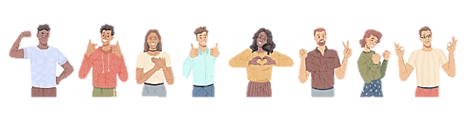
Today’s Agenda
Abstract
Introduction
Literature survey
Methodology
Data Set
Proposed methodology
Future scope
Conclusion
AGENDA
2

Slide 3

ABSTRACT
Human–Computer Interfaces (HCI) is the study of how humans and computers interact. Hand gestures are a great way to communicate with individuals who don't comprehend what we're saying, especially when they don't understand what we're saying.
We are planning to develop a project in order to help communicate issues for speech-impaired individuals. This project presents the conversion of sign language to text format. Using the best possible method after analysis, an application is developed that can convert real-time Sign Language signs to letters(alphabet). By using the deep learning mechanism we implement the project, this majorly includes the Neural networks.
3

Slide 4

INTRODUCTION
Sign language is a visual language that uses hand gestures, facial expressions, and body movements to communicate. It is used by deaf and hard-of-hearing people as their primary means of communication.
Sign language has its own grammar and syntax, which are different from spoken languages. It also varies from country to country, with each having its own sign language.
Human–computer interaction (HCI) approaches range from simple keyboard inputs to advanced vision-based gesture detection systems.
Hand gesture recognition is one of the most exciting and important HCI technologies
Hand gesture recognition is an intriguing research subject since it may be used to improve communication in a number of applications such as mobile phones, smart TVs, robot controllers, medical equipment, access control systems, and smart automobiles.
4

Slide 5
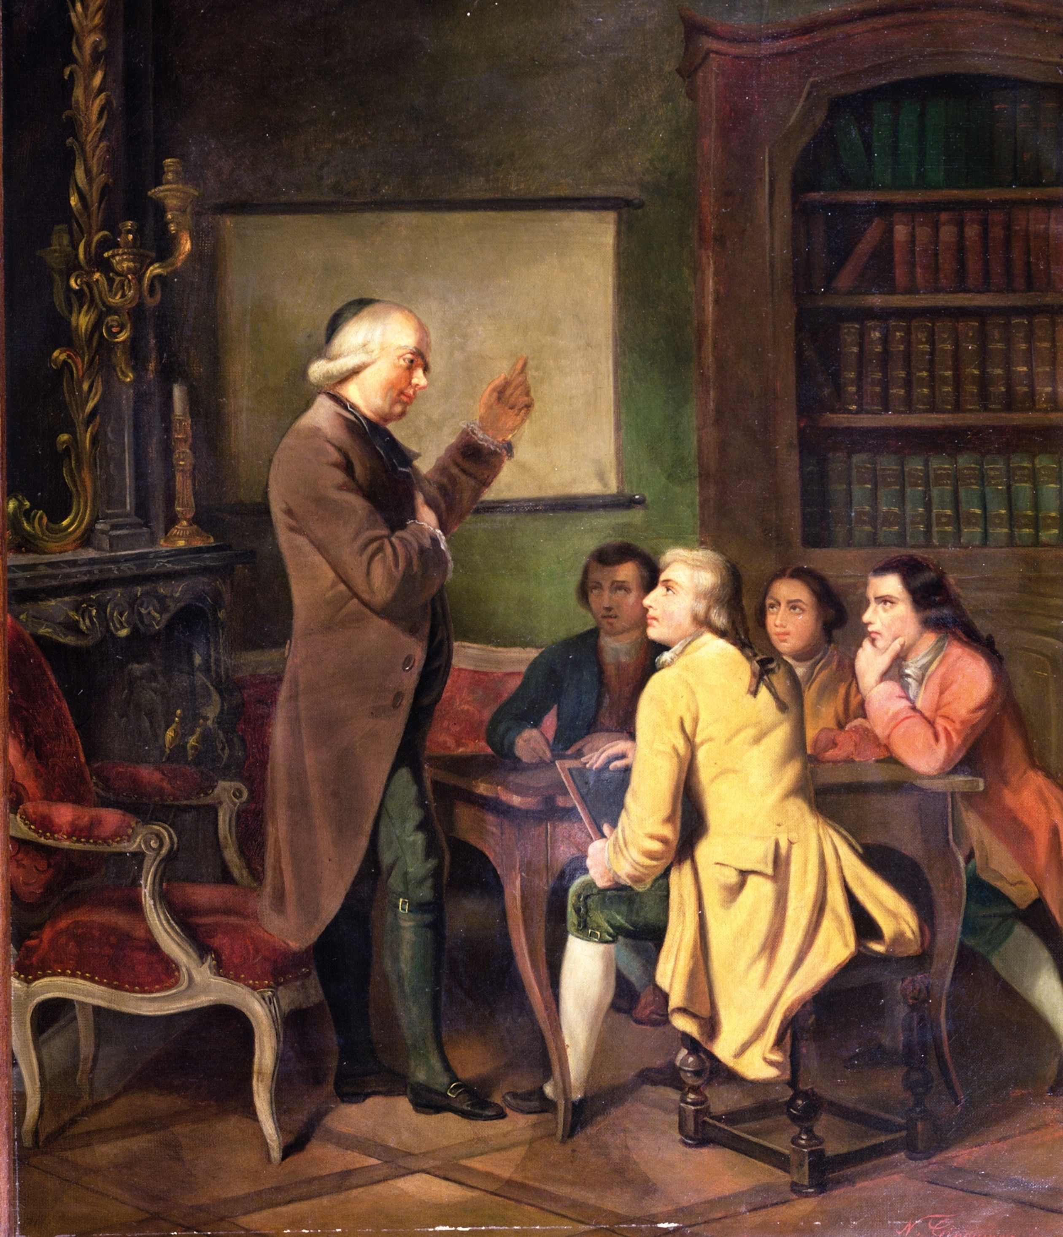
HISTORY of SIGN-LANGUAGE
Sign language has a long history, dating back to ancient civilizations such as the Greeks and Romans who used hand gestures to communicate.
In the 18th century, the first school for the deaf was established in France, where French Sign Language (LSF) was developed. Later, American Sign Language (ASL) was created by combining LSF with indigenous sign languages used by Native Americans.

Slide 6

LITERATURE SURVEY
S.NO | ARTICLE TITLE | AUTHOR NAME | METHODOLOGY | ACCURACY
1. | Indian Sign Language Recognition System | Yogeshwar I. Rokade | ANN | 94%
2. | American Sign Language Recognition System | Shivashankara S | SVM | 93.05%
3. | Research of a sign language translation system | Siming He | CNN | 91.7%
4. | Sign Language Translator | Divyanshu Mishra, MedhaviTyagi | DBSCAN | 93%
5. | Recognition of Single-Handed Sign Language Gestures | Rohit Sharma, YashNemani, Sumit Kumar | SVM | 62.3%
6

Slide 7
LITERATURE SURVEY
S.NO | ARTICLE TITLE | AUTHOR NAME | METHODOLOGY | ACCURACY
6. | Real-Time American Sign Language Recognition with Faster Regional Convolutional Neural Networks | S. Dinesh,S. Sivaprakash | CNN | 93.33%
7. | SIGN LANGUAGE RECOGNITION: STATE OF THE ART | Ashok K Sahoo, GouriSankar Mishra | Bayesian Network | 87.64%
8. | Sign Language Recognition using Convolutional Neural Networks | Lionel Pigou, Sander Dieleman | ANN | 91.7%
9. | Indian Sign Language Recognition System | Yogeshwar I. Rokade, Prashant M. Jadav | SVM | 92%
10. | Sign language recognition system using CNN and Computer Vision | MehreenHurroo, Mohammad ElhamWalizad | CNN | 90%
7

Slide 8

METHODOLOGY
EXISTING METHODOLOGY
Many researchers have proposed numerous methods for Hand Gesture Recognition Systems.
Glove Based
Requires use of hand gloves.
Complex to use.
Variable glove size for more users.
Environment Dependent.
Electronics Based
Use of electronic hardware
Complex to use
Physical attachment with the system required
Lot of noise in the transition
8

Slide 9
METHODOLOGY
EXISTING METHODOLOGY
Many researchers have proposed numerous methods for Hand Gesture Recognition Systems.
As per our survey throughout the project, we have an existing methodology as “Bayesian Network”.
A Bayesian network is a probabilistic graphical model that represents a set of variables and their conditional dependencies through a directed acyclic graph. It can be used for a variety of machine-learning tasks, including sign language recognition.
To apply Bayesian networks to sign language recognition, the first step is to collect a dataset of sign language videos. Each video should show a person performing a sign or a sequence of signs. The videos can be preprocessed to extract relevant features, such as the position and movement of the hands and arms, as well as facial expressions.
Once the videos have been preprocessed, a Bayesian network can be constructed to model the conditional dependencies between the sign language features and the corresponding sign language gestures. The variables in the network could include features such as hand position, hand movement, and facial expression, as well as variables representing the sign language gestures themselves.
9

Slide 10

DATA SET
The "MNIST handwritten dataset," which is a widely-used dataset in machine learning and computer vision research.
The MNIST dataset is a collection of 70,000 grayscale images of handwritten digits (0-9) and alphabets with a resolution of 28 x 28 pixels. The dataset is divided into two sets: a training set of 60,000 images and a test set of 10,000 images.
The MNIST dataset has been widely used as a benchmark for evaluating machine learning algorithms, particularly for image classification tasks.
The dataset has been used to train and evaluate various models such as artificial neural networks, convolutional neural networks, and support vector machines, among others.
The dataset has also been used as a benchmark for evaluating new machine learning techniques, such as deep learning and generative models.
10

Slide 11
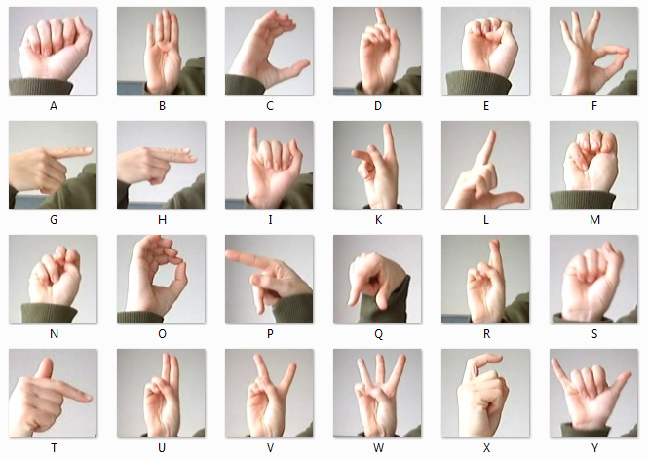
DATA SET
import numpy as np
import matplotlib.pyplot as plt
from tensorflow.keras.datasets import mnist
# Load the MNIST dataset
(X_train, y_train), (X_test, y_test) = mnist.load_data()
# Display some of the images
fig, ax = plt.subplots(nrows=4, ncols=6, figsize=(8, 8))
for i in range(4):
for j in range(6):
k = np.random.randint(0, len(X_train))
ax[i, j].imshow(X_train[k], cmap='gray')
ax[i, j].set_title(f"Label: {y_train[k]}")
ax[i, j].axis('off')
plt.tight_layout()
plt.show()
11

Slide 12


PROPOSED METHODOLOGY
The machine learning algorithm used in this project is a convolutional neural network (CNN), which is a type of deep learning model commonly used for image classification tasks.
The model is trained using the Adam optimizer and the categorical cross-entropy loss function.
Once the model is trained, the code uses OpenCV to capture frames from the video stream and preprocess them.
The preprocessed image is then passed to the trained model to recognize the ASL alphabet letter in the image.
The model predicts the letter by computing the class probabilities for each letter, and the letter with the highest probability is selected as the prediction. The recognized letter is then displayed on the video stream using OpenCV.
12

Slide 13
CONCLUSION
In this project, a functional real time vision based American sign language recognition for Deaf and Dumb people have been developed for asl alphabets. We achieved final accuracy of 98.0% on our dataset. MNIST dataset, which contains images of handwritten digits, we were able to recognize the ASL alphabet letters captured by a video stream. The model was able to achieve a high accuracy on the test set and performed well in real-time on the video stream. We are able to improve our prediction after implementing two layers of algorithms in which we verify and predict symbols which are more similar to each other. This way we are able to detect almost all the symbols provided that they are shown properly, there is no noise in the background and lighting is adequate.
13

Slide 14
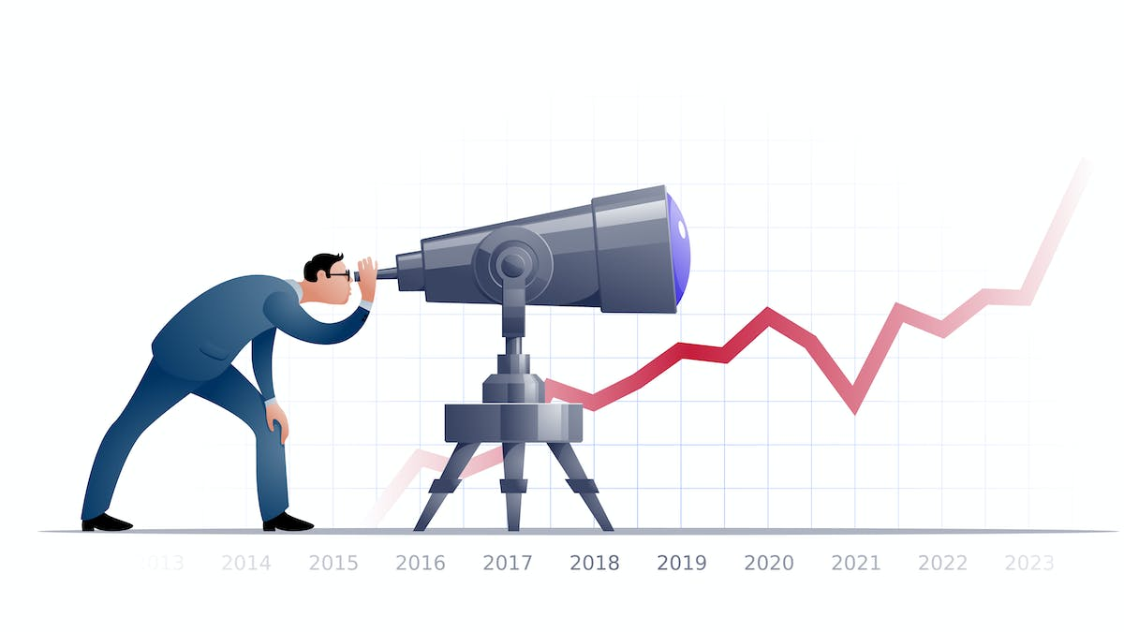
FUTURE SCOPE
Advancements in technology have made sign language more accessible than ever before. Video conferencing platforms now offer real-time captioning and sign-language interpretation services, making it easier for deaf and hard-of-hearing individuals to communicate remotely.
However, there is still a lot of work to be done in terms of improving access to sign-language education and resources, particularly in developing countries. The future of sign language depends on continued advocacy and support for the deaf community.

